Slide 1
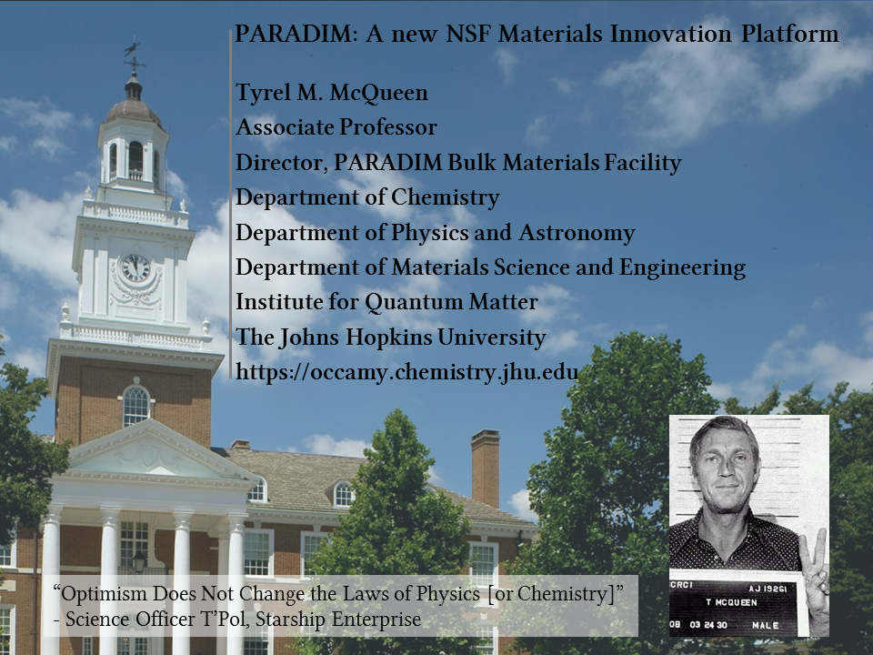

Slide 2
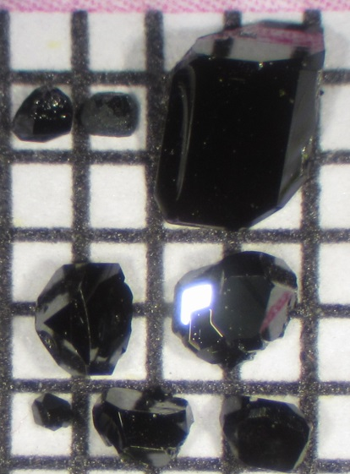

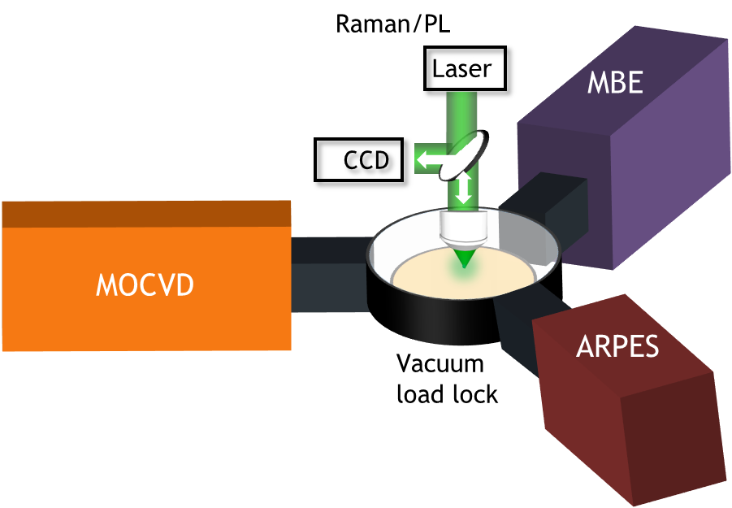

Materials by Design Gets Serious!
New $25 Million NSF “Platform” on Interface Materials —by Design!
ACTIVE SUBSTRATE + THIN FILM
New Chemistry
New Physics
New Materials Science
Director: Darrell Schlom (Cornell)
http://paradim.org

Slide 3
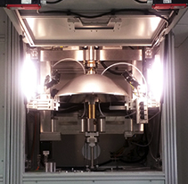
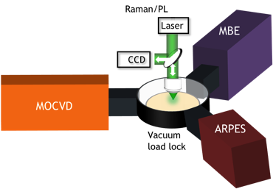
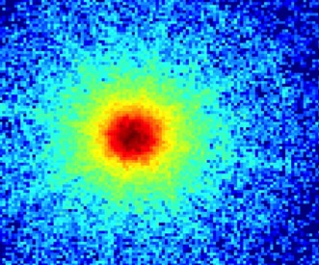
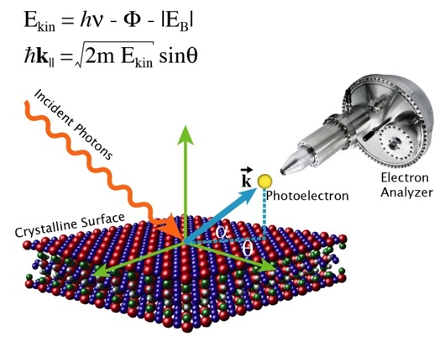
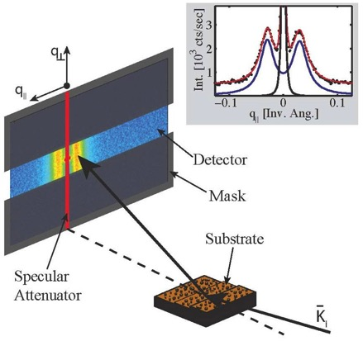
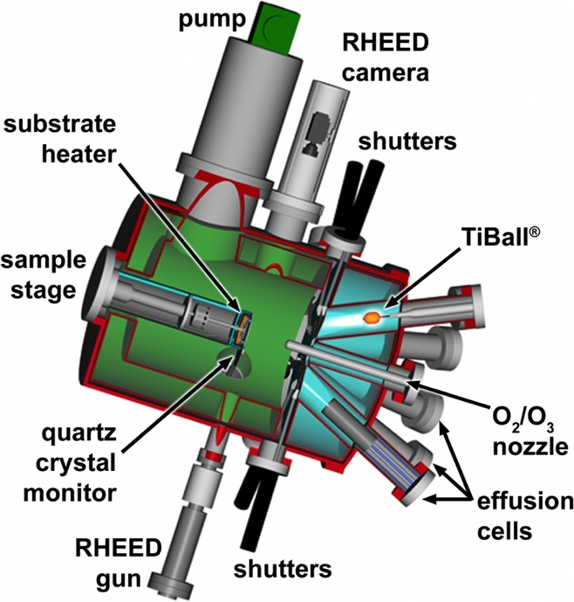
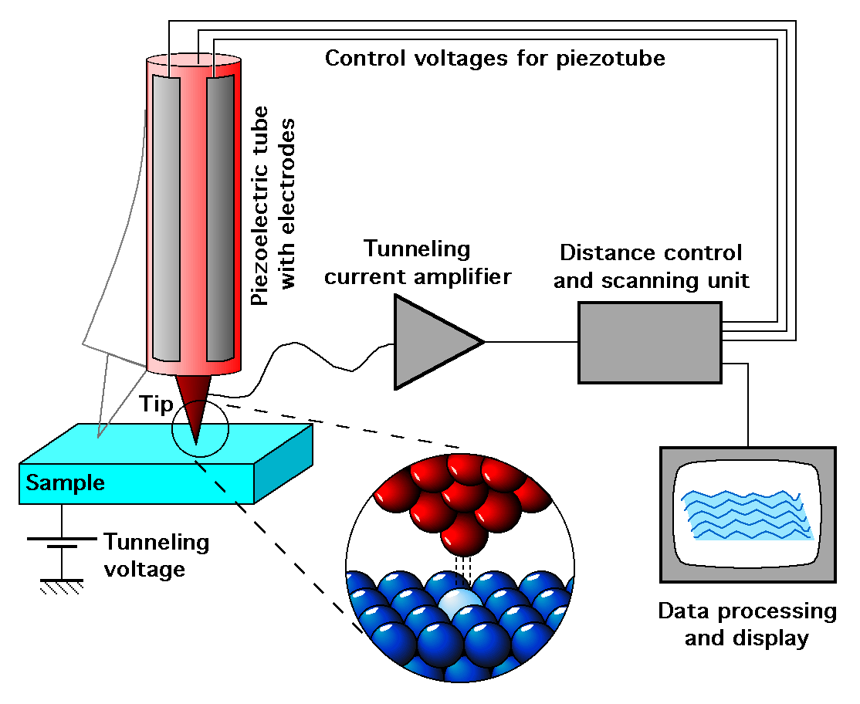
PARADIM — A National User Facility
Theory to help guide; informed by experiment
High-pressure (supercritical fluid) floating-zone growth
Mass spectrometry during bulk crystal growth
Integrated MBE + ARPES + MOCVD
High sensitivity, high dynamic range pixel array detector for quantitative mapping of E and B fields
with sub-nm resolution
Stable cryo-stages for STEM and STEM-EELS
Free to the highest ranked user proposals from
U.S.A. academic institutions or national labs
All samples produced in PARADIM belong to the user
Optimized recipes eventually become public domain
PARADIM interns utilize optimized recipes to fulfill sample requests
THEORY (Fennie, Hennig, Kim, Lawler)
THEORY (Fennie, Hennig, Kim, Lawler)
THEORY (Fennie, Hennig, Kim, Lawler)
THEORY (Fennie, Hennig, Kim, Lawler)
THEORY (Fennie, Hennig, Kim, Lawler)
THEORY (Fennie, Hennig, Kim, Lawler)
X-RAY
DIFFRACTION
(Brock)
X-RAY
DIFFRACTION
(Brock)
X-RAY
DIFFRACTION
(Brock)
X-RAY
DIFFRACTION
(Brock)
X-RAY
DIFFRACTION
(Brock)
X-RAY
DIFFRACTION
(Brock)
SCANNING
TUNNELING
MICRSOCOPY
(Davis)
SCANNING
TUNNELING
MICRSOCOPY
(Davis)
SCANNING
TUNNELING
MICRSOCOPY
(Davis)
SCANNING
TUNNELING
MICRSOCOPY
(Davis)
SCANNING
TUNNELING
MICRSOCOPY
(Davis)
SCANNING
TUNNELING
MICRSOCOPY
(Davis)
GROWTH (Schlom)
Molecular-Beam Epitaxy
GROWTH (Schlom)
Molecular-Beam Epitaxy
GROWTH (Schlom)
Molecular-Beam Epitaxy
GROWTH (Schlom)
Molecular-Beam Epitaxy
GROWTH (Schlom)
Molecular-Beam Epitaxy
GROWTH (Schlom)
Molecular-Beam Epitaxy
TRANSMISSION ELECTRON
MICROSCOPY (Muller)
TRANSMISSION ELECTRON
MICROSCOPY (Muller)
TRANSMISSION ELECTRON
MICROSCOPY (Muller)
TRANSMISSION ELECTRON
MICROSCOPY (Muller)
TRANSMISSION ELECTRON
MICROSCOPY (Muller)
TRANSMISSION ELECTRON
MICROSCOPY (Muller)
Notes:
Some guiding principles of PARADIM
The materials you invent belong to you, including all IP. We simply provide the equipment and the expertise in how to use it.

Slide 4
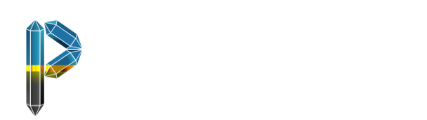
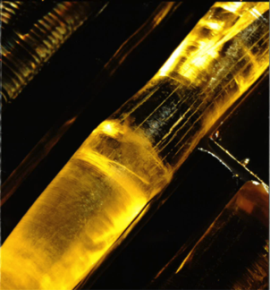

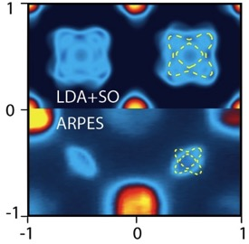
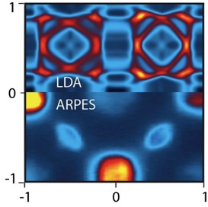
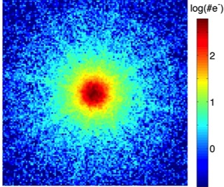
User Facilities
Bulk
Thin Film
New Chemistry
New Physics
New Materials Science
New Materials
Theory & Computation
Electron Microscopy
Characterization
k_{y} (π/a)
k_{x} (π/a)
Notes:
PARADIM consists of 4 user facilities. Users are welcome to use as few or as many of our user facilities as they wish. The idea is for PARADIM user facilities to fill the gaps in your capabilities.

Slide 5
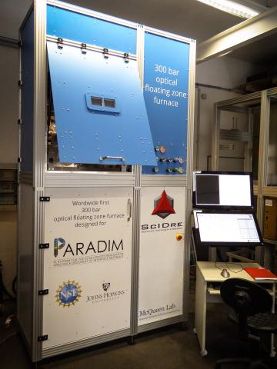
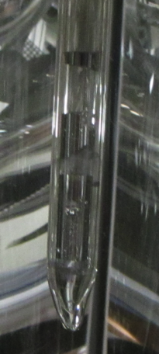
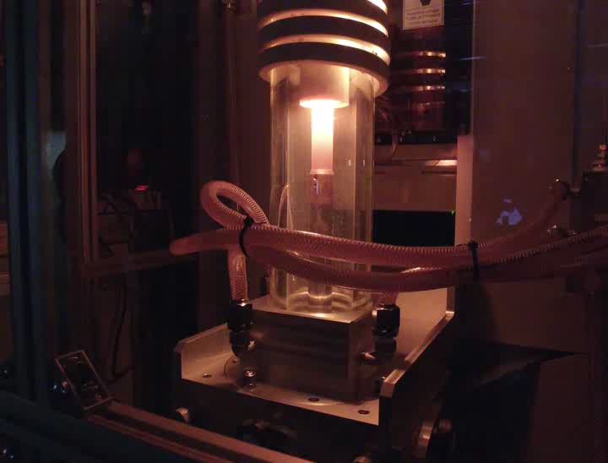
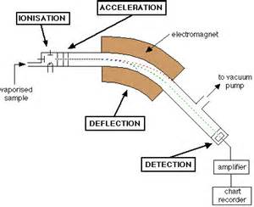
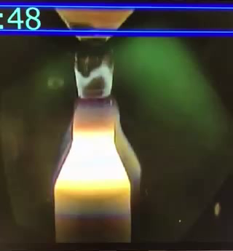
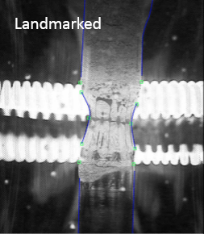
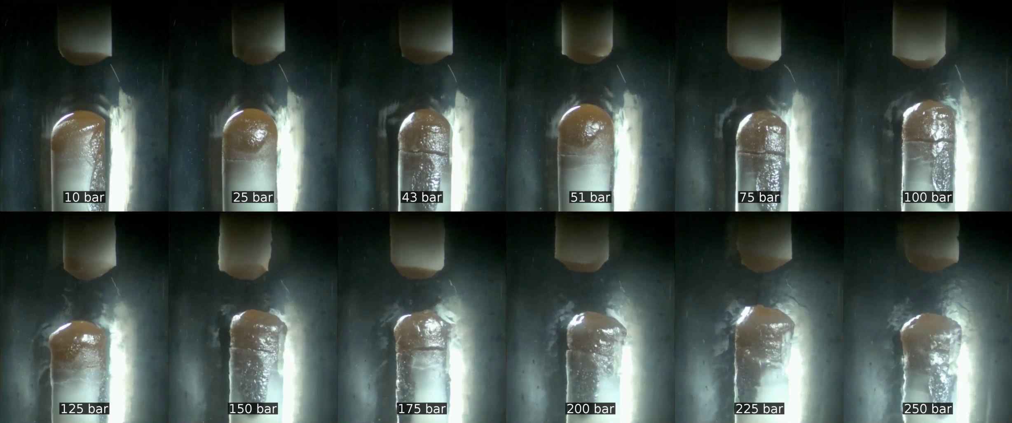

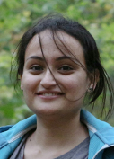
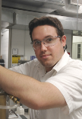


Bulk Materials Discovery User Facility
Expanded Growth Conditions, in situ Growth Guidance
Vapor Equilibria
Machine Learning
Safe highly toxics,
Bridgeman in FZ
P = 300 atm (first in world)
Supercritical fluids
Laser-heated floating zone
THEORY (Fennie, Hennig, Kim, Lawler)
THEORY (Fennie, Hennig, Kim, Lawler)
THEORY (Fennie, Hennig, Kim, Lawler)
THEORY (Fennie, Hennig, Kim, Lawler)
THEORY (Fennie, Hennig, Kim, Lawler)
THEORY (Fennie, Hennig, Kim, Lawler)
X-RAY
DIFFRACTION
(Brock)
X-RAY
DIFFRACTION
(Brock)
X-RAY
DIFFRACTION
(Brock)
X-RAY
DIFFRACTION
(Brock)
X-RAY
DIFFRACTION
(Brock)
X-RAY
DIFFRACTION
(Brock)
SCANNING
TUNNELING
MICRSOCOPY
(Davis)
SCANNING
TUNNELING
MICRSOCOPY
(Davis)
SCANNING
TUNNELING
MICRSOCOPY
(Davis)
SCANNING
TUNNELING
MICRSOCOPY
(Davis)
SCANNING
TUNNELING
MICRSOCOPY
(Davis)
SCANNING
TUNNELING
MICRSOCOPY
(Davis)
GROWTH (Schlom)
Molecular-Beam Epitaxy
GROWTH (Schlom)
Molecular-Beam Epitaxy
GROWTH (Schlom)
Molecular-Beam Epitaxy
GROWTH (Schlom)
Molecular-Beam Epitaxy
GROWTH (Schlom)
Molecular-Beam Epitaxy
GROWTH (Schlom)
Molecular-Beam Epitaxy
TRANSMISSION ELECTRON
MICROSCOPY (Muller)
TRANSMISSION ELECTRON
MICROSCOPY (Muller)
TRANSMISSION ELECTRON
MICROSCOPY (Muller)
TRANSMISSION ELECTRON
MICROSCOPY (Muller)
TRANSMISSION ELECTRON
MICROSCOPY (Muller)
TRANSMISSION ELECTRON
MICROSCOPY (Muller)
Notes:
Now a high pressure series is shown in bottom left (Al2O3 up to 250 atm of O2), the induction in the middle top, and an example of computer vision / machine learning applied to interpreting the growth videos. The vision of this last bit is to be able to extract 3D, relevant parameters (fluid flow, shape changes, etc.) in a meaningful way for the operator and is an example of *quantitation* of an in situ measurement qualitatively used for decades...

Slide 6
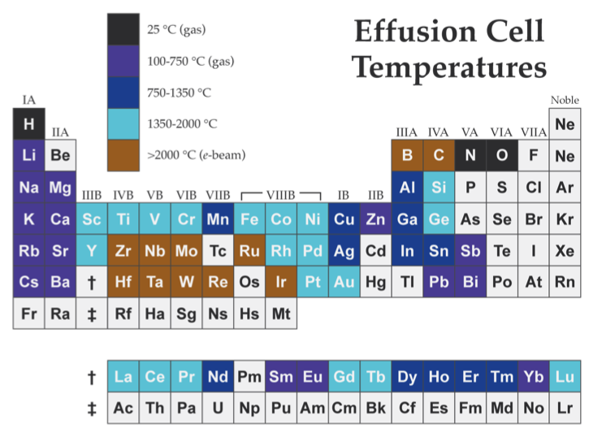
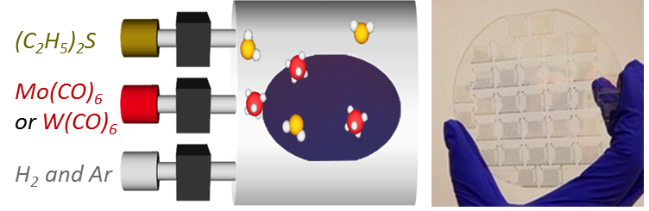
Thin Film User Facility
Expanded Growth Conditions
Routine, in situ Growth and Characterization
MBE of any 11 of 62 elements at one time
(and refills without breaking chamber vacuum)
T_{sub} < 1000 °C
Many others (e.g., chalcogenides) via MOCVD
MOCVD of 1 ML thick MoS₂, MoSe₂, WS₂, WSe₂ over 4” wafers (Kang et al.—Nature 2015 + Nature 2017)

Slide 7
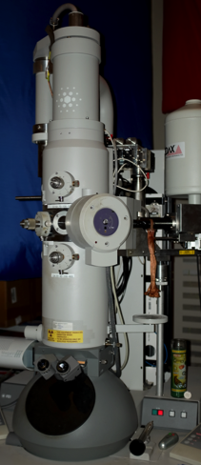
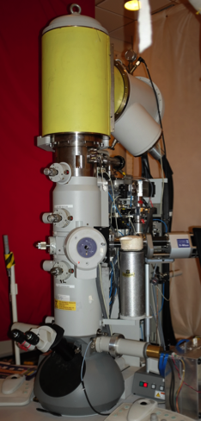
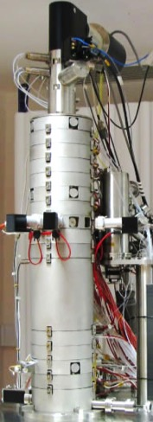
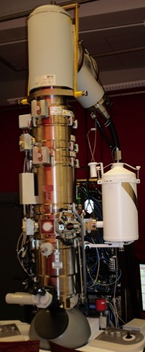
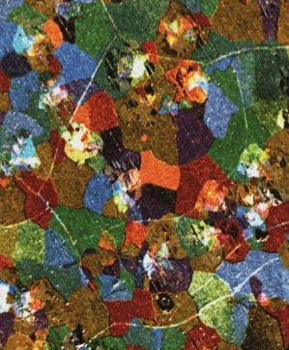
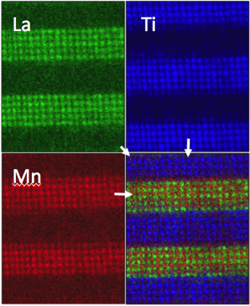
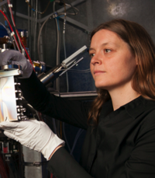
Electron Microscopy User Facility
FEI T12 TEM
FEI F20 monochromated S/TEM
Probe corrected Nion UltraSTEM
Probe Corrected FEI Titan Themis cryoSTEM
First 5th order aberration corrected STEM
First of its kind cryoSTEM
Imaging grains in
2D materials
Atomic resolution Elemental Mapping
Atomic resolution imaging + spectroscopic mapping at LN₂ temp.
Magnetic imaging by Lorentz TEM
Atomic resolution Imaging
Park, McEuen, Muller,
Nature 469 (2011) 389
Kourkoutis, Song, Hwang, Muller, PNAS 107 (2010) 11682
Muller, Kourkoutis, Murfitt, Song, Hwang, Silcox, Dellby, Krivanek, Science 319 (2008) 1073
Lena Kourkoutis

Slide 8
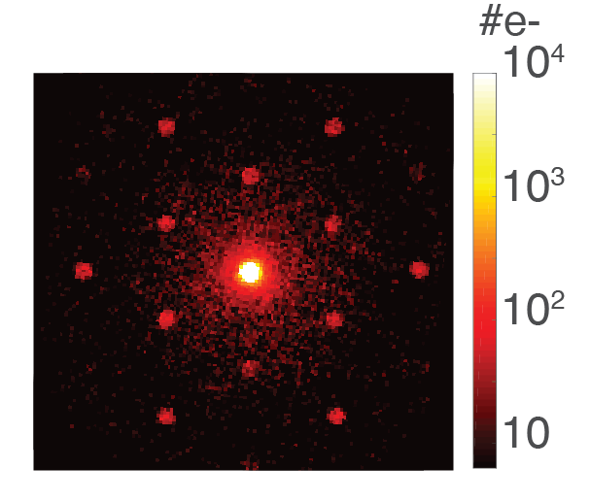
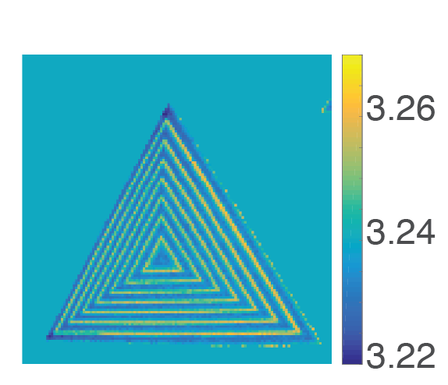
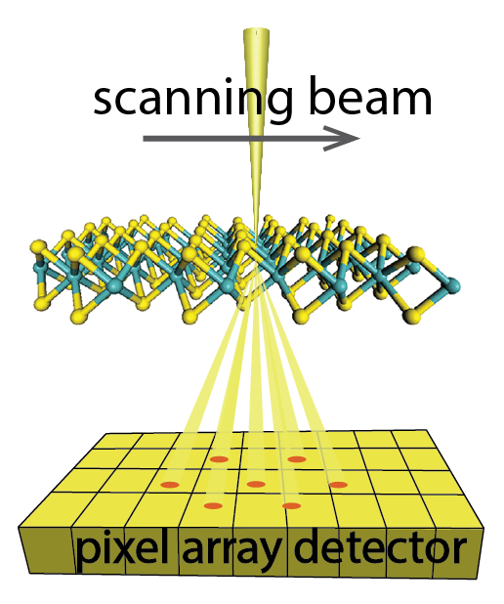
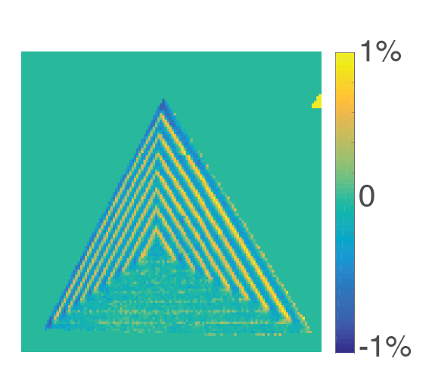
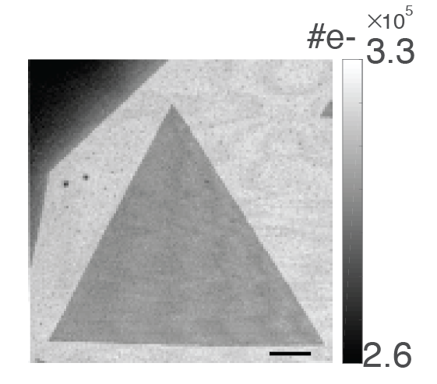
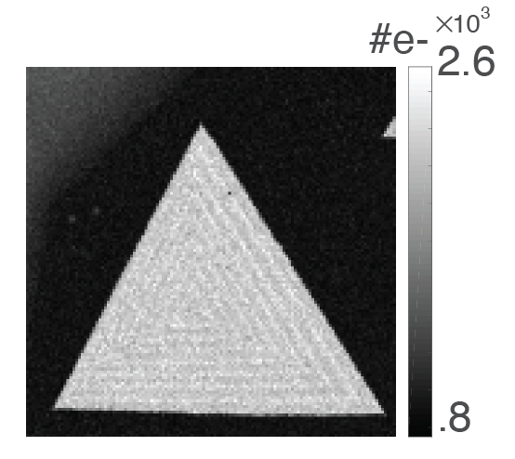
Electron Microscope Pixel Array Detector (EMPAD)
Records every electron that passes through the sample, at every probe position!
Single Electron Sensitivity (noise is 1/50 e–)
e⁻ Dynamic Range > 1,000,000:1
# e-
Lattice constant map
Diffraction pattern in 1 ms
10⁴
(Å)
500 nm
3.26
10³
WS₂
WSe₂
3.24
10²
3.22
10
Uniaxial strain map
1%
High Speed:
0.86 ms/frame
5 nm SiN_{x}
Relaxed
Relaxed
0
Monolayer
WS₂-WSe₂ multijunctions
500 nm
Strained
–1%
M.W. Tate et al. Microsc. & Microanal. 22, 237 (2016)
Notes:
-We have developed a new pixel array detector for electron microscopes. This detector can handle very high beam currents at very readout speeds, yet retains single-electron sensitivity.
-Anim 1: This lets us record diffraction patterns from 2D materials with a focused probe in less than 1 ms – much faster than any other detector, and this lets us record not 1 diffraction pattern, but 100’s of thousands that we can put together into a 4D data set.
-Anim 2:This lets us not only reproduce all elastic imaging modes of the microsocpe simultanously – e.g birght and dark field imaging, but new imaging modes as well.
-Anim 3 & 4: A simple example is mapping lattice strain in 2D monolayers – here a coherently strained set of lateral junctions in WS2 and WSe2

Slide 9
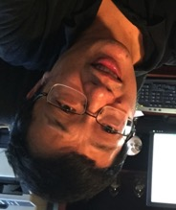
Theory User Facility
Helping to close the gap with experiment
Two modes of operation
Consultation—Advise and Help Collaboration—coauthoring
Key elements:
  Fundamental theory
  Well-known Algorithms
  Software packages
  Efficiency techniques
Aided by: Materials-by-Design Toolbox
  Community
  On-Line Short Courses
  Open-source code
  Databases
  Tutorials
  Written instructions
Key elements:
Advanced/new theory
Advanced/new Algorithms
Specialty Software packages
Runtime optimization
Aided by: Materials-by-Design Toolbox
Community
Databases
Commercial codes
Specialized codes
Code modifications
Larry Wang
THEORY (Fennie, Hennig, Kim, Lawler)
THEORY (Fennie, Hennig, Kim, Lawler)
THEORY (Fennie, Hennig, Kim, Lawler)
THEORY (Fennie, Hennig, Kim, Lawler)
THEORY (Fennie, Hennig, Kim, Lawler)
THEORY (Fennie, Hennig, Kim, Lawler)
X-RAY
DIFFRACTION
(Brock)
X-RAY
DIFFRACTION
(Brock)
X-RAY
DIFFRACTION
(Brock)
X-RAY
DIFFRACTION
(Brock)
X-RAY
DIFFRACTION
(Brock)
X-RAY
DIFFRACTION
(Brock)
SCANNING
TUNNELING
MICRSOCOPY
(Davis)
SCANNING
TUNNELING
MICRSOCOPY
(Davis)
SCANNING
TUNNELING
MICRSOCOPY
(Davis)
SCANNING
TUNNELING
MICRSOCOPY
(Davis)
SCANNING
TUNNELING
MICRSOCOPY
(Davis)
SCANNING
TUNNELING
MICRSOCOPY
(Davis)
GROWTH (Schlom)
Molecular-Beam Epitaxy
GROWTH (Schlom)
Molecular-Beam Epitaxy
GROWTH (Schlom)
Molecular-Beam Epitaxy
GROWTH (Schlom)
Molecular-Beam Epitaxy
GROWTH (Schlom)
Molecular-Beam Epitaxy
GROWTH (Schlom)
Molecular-Beam Epitaxy
TRANSMISSION ELECTRON
MICROSCOPY (Muller)
TRANSMISSION ELECTRON
MICROSCOPY (Muller)
TRANSMISSION ELECTRON
MICROSCOPY (Muller)
TRANSMISSION ELECTRON
MICROSCOPY (Muller)
TRANSMISSION ELECTRON
MICROSCOPY (Muller)
TRANSMISSION ELECTRON
MICROSCOPY (Muller)

Slide 10
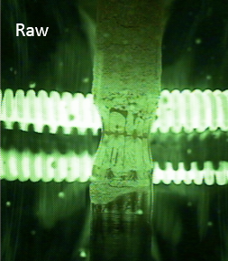
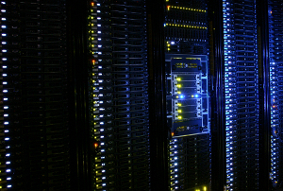
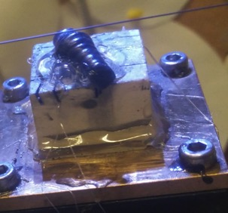
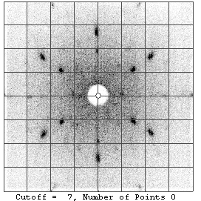
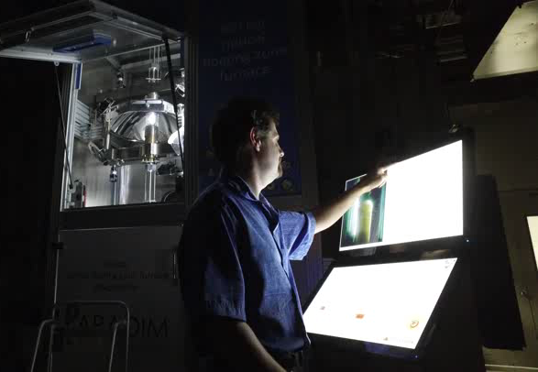

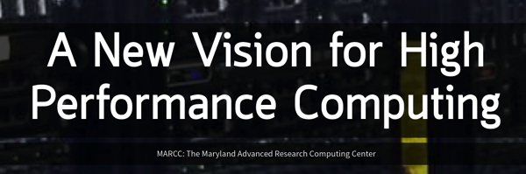

Maximizing Data Availability and Usability
“Collect Everything,” “Use everything,” “Make available everything”
Machine Learning
Sloan Foundation and JHU
All data available online
NSF ACI-1261715
THEORY (Fennie, Hennig, Kim, Lawler)
THEORY (Fennie, Hennig, Kim, Lawler)
THEORY (Fennie, Hennig, Kim, Lawler)
THEORY (Fennie, Hennig, Kim, Lawler)
THEORY (Fennie, Hennig, Kim, Lawler)
THEORY (Fennie, Hennig, Kim, Lawler)
X-RAY
DIFFRACTION
(Brock)
X-RAY
DIFFRACTION
(Brock)
X-RAY
DIFFRACTION
(Brock)
X-RAY
DIFFRACTION
(Brock)
X-RAY
DIFFRACTION
(Brock)
X-RAY
DIFFRACTION
(Brock)
SCANNING
TUNNELING
MICRSOCOPY
(Davis)
SCANNING
TUNNELING
MICRSOCOPY
(Davis)
SCANNING
TUNNELING
MICRSOCOPY
(Davis)
SCANNING
TUNNELING
MICRSOCOPY
(Davis)
SCANNING
TUNNELING
MICRSOCOPY
(Davis)
SCANNING
TUNNELING
MICRSOCOPY
(Davis)
GROWTH (Schlom)
Molecular-Beam Epitaxy
GROWTH (Schlom)
Molecular-Beam Epitaxy
GROWTH (Schlom)
Molecular-Beam Epitaxy
GROWTH (Schlom)
Molecular-Beam Epitaxy
GROWTH (Schlom)
Molecular-Beam Epitaxy
GROWTH (Schlom)
Molecular-Beam Epitaxy
TRANSMISSION ELECTRON
MICROSCOPY (Muller)
TRANSMISSION ELECTRON
MICROSCOPY (Muller)
TRANSMISSION ELECTRON
MICROSCOPY (Muller)
TRANSMISSION ELECTRON
MICROSCOPY (Muller)
TRANSMISSION ELECTRON
MICROSCOPY (Muller)
TRANSMISSION ELECTRON
MICROSCOPY (Muller)
Notes:
Top left shows the vision described in slide 3 instantiated. Rest of slide lists all the folks (CAU, SciServer, SciDrive, MARCC)
making PARADIM data happen.

Slide 11
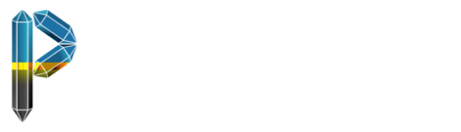
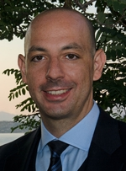
2018 Summer Schools
    Johns Hopkins: Exotic Magnetic States in Quantum Materials
June 17-22
Cornell: An Introduction to Density Functional Theory for
Experimentalists
July 8-13
PARADIM Summer Schools are FREE to all participants (industry too)
Instructor: Feliciano Giustino
Professor of Materials
University of Oxford
www.paradim.org
Notes:
JHU will be either going with a "big data" or a "quantum materials" theme -- we decide this coming Wednesday internally.

Slide 12
PARADIM — A National User Facility
Theory to help guide; informed by experiment
High-pressure (supercritical fluid) floating-zone growth
Mass spectrometry during bulk crystal growth
Integrated MBE + ARPES + MOCVD
High sensitivity, high dynamic range pixel array detector for quantitative mapping of E and B fields
with sub-nm resolution
Stable cryo-stages for STEM and STEM-EELS
Free to the highest ranked user proposals from
U.S.A. academic institutions or national labs
All samples produced in PARADIM belong to the user
Optimized recipes eventually become public domain
PARADIM interns utilize optimized recipes to fulfill sample requests
THEORY (Fennie, Hennig, Kim, Lawler)
THEORY (Fennie, Hennig, Kim, Lawler)
THEORY (Fennie, Hennig, Kim, Lawler)
THEORY (Fennie, Hennig, Kim, Lawler)
THEORY (Fennie, Hennig, Kim, Lawler)
THEORY (Fennie, Hennig, Kim, Lawler)
X-RAY
DIFFRACTION
(Brock)
X-RAY
DIFFRACTION
(Brock)
X-RAY
DIFFRACTION
(Brock)
X-RAY
DIFFRACTION
(Brock)
X-RAY
DIFFRACTION
(Brock)
X-RAY
DIFFRACTION
(Brock)
SCANNING
TUNNELING
MICRSOCOPY
(Davis)
SCANNING
TUNNELING
MICRSOCOPY
(Davis)
SCANNING
TUNNELING
MICRSOCOPY
(Davis)
SCANNING
TUNNELING
MICRSOCOPY
(Davis)
SCANNING
TUNNELING
MICRSOCOPY
(Davis)
SCANNING
TUNNELING
MICRSOCOPY
(Davis)
GROWTH (Schlom)
Molecular-Beam Epitaxy
GROWTH (Schlom)
Molecular-Beam Epitaxy
GROWTH (Schlom)
Molecular-Beam Epitaxy
GROWTH (Schlom)
Molecular-Beam Epitaxy
GROWTH (Schlom)
Molecular-Beam Epitaxy
GROWTH (Schlom)
Molecular-Beam Epitaxy
TRANSMISSION ELECTRON
MICROSCOPY (Muller)
TRANSMISSION ELECTRON
MICROSCOPY (Muller)
TRANSMISSION ELECTRON
MICROSCOPY (Muller)
TRANSMISSION ELECTRON
MICROSCOPY (Muller)
TRANSMISSION ELECTRON
MICROSCOPY (Muller)
TRANSMISSION ELECTRON
MICROSCOPY (Muller)
Notes:
Some guiding principles of PARADIM
The materials you invent belong to you, including all IP. We simply provide the equipment and the expertise in how to use it.

Slide 13
